Slide 1
Rotary and Ethics
RLI - Part II
Notes:
Begin the session:
Introduce self
Describe format for the session
Talk about what materials are available and/or where they can be found

Slide 2
Goals:
Discuss
How should the Guiding Principles of Rotary strengthen me in my vocation?
Develop
Basis for the Development of an ethics statement for your Rotary club.
Recognize
The Four Way Test and Rotary Code of Ethics as Foundation principles.
Reflect
How can I promote Rotary and Rotary ideals within my vocation?
Notes:
1. Review Session Goals, where this course fits into the Membership curriculum of RLI
Session Goals
How should the Guiding Principles of Rotary strengthen me in my vocation?
How can I promote Rotary and Rotary ideals within my vocation?
2. Invite participants to refer to the Rotary & Ethics section of the Participant Manual – RE-1, RE-2, RE-3 – for reference.

Slide 3
Virtual Introduction
Click on the symbol up in the right-hand corner of your image and change your name to your first name and Rotary Club.
Check the Reactions and Click the one you prefer to indicate you are finished.
Notes:
Participants will change their name on their image to identify their club.
They will use the reactions to indicate that they are finished.
This is a way to have participants practice changing their name and using the reactions.

Slide 4

What first comes to your mind when you hear…
ROTARY & ETHICS
Notes:
Present the question on the screen:
Write down your initial thoughts. Raise your VIRTUAL HAND to respond.
Take one or two examples
Ask for any additional thoughts and/or surprises

Slide 5

Breakout Groups: Issues
Misuse of Funds
Forming a Satellite
Name Change
Notes:
Set up the Breakouts
Assign participants to one of three breakout groups.
Each group will review a specific scenario
Misuse of Funds
Forming a Satellite
Name Change
The sample scenarios are available in My Event.
Provide directions for the breakout:
In this exercise we will explore an issue that might be faced by a Rotary Board of Directors. You will be assigned to one of three breakout rooms. Breakout A – Misuse of Funds; Breakout B – Forming a Satellite; Breakout C – Name Change
Review the scenario and identify the issue(s).
Determine the considerations that need to be addressed.
Develop an action plan including how (or whether) to share the issue to the club
We’ll bring you back to the main room to discuss your findings after 10 minutes.
Each group needs to identify a spokesperson to report on the group’s conclusions.
Once the Breakout starts, share the next slide to Breakout Rooms.

Slide 6
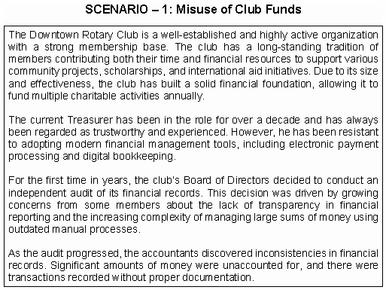
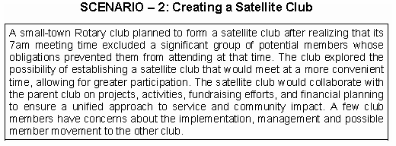
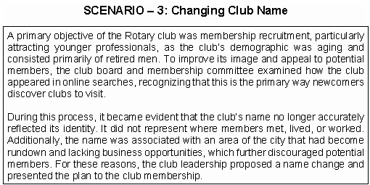
Review the scenario and identify the issue(s).
Determine the considerations that need to be addressed.
Develop an action plan including how (or whether) to share the issue to the club.
Choose a spokesperson to report out.
Notes:
In order to share this slide to breakout rooms, you don’t need to stop sharing. Just hit the Share button again, and maker sure you click the option to “Share to Breakouts” along the right side of the screen. This option is not available until AFTER breakouts are started.
You may also “Broadcast” your voice to breakouts if you wish to give them more specific instructions, such as letting them know who is in each breakout. If you draw or mark anything on YOUR screen using Annotation Tools, they will also see that in the breakouts.
Note: If the person sharing (normally the Facilitator) joins a breakout, screen sharing will stop. For this reason, it may make sense to use a second computer to visit participants in breakouts, or to have the Producer share this slide to breakouts.

Slide 7

Group Reports
ISSUE
CONSIDERATIONS
ACTION PLAN
Notes:
Ask breakout group spokespersons to report back from their breakout group.
NOTE: Hidden Scenario – The set-up is a modern take on the “Four Way Test” situation encountered by Rotarian Herbert J. Taylor, later President of Rotary International, at the Club Aluminum Company of Chicago in 1932. The remainder of this session will focus on the evolution and current use of the Four Way Test.

Slide 8

What are the ETHICAL Issues?
Notes:
Refer to the question on the slide
What are the ethical issues raised in the breakout scenarios?
Let’s hear your thoughts.
Direct participants to unmute to respond or raise their virtual hand

Slide 9

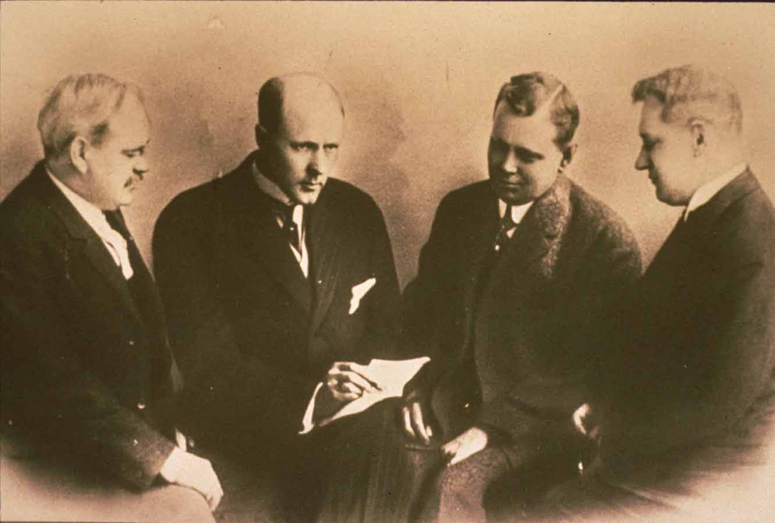
History of Ethics and Rotary
By the 1930’s Paul Harris worried that The Golden Rule probably needed to be abandoned by Rotary to avoid religious overtones but doing so would deny a core value of Rotary. The solution was the Four-Way Test.
Notes:
Introduce the group to the ethical foundation in Rotary and how it developed.
The historical perspective include the following:
CHICAGO @ 1900: “Regional divisions, ethnic and racial tensions, intense partisan rivalries, conflicting special-interest groups, and political corruption have characterized the complex political culture of Illinois,” (Taken from Encyclopedia of Chicago)
Paul Harris had a vision to create a fellowship of businessmen from different occupations based on ethical behavior in all aspects of life.
Point out the importance of Integrity and its prominence as one of Rotary’s Core Values

Slide 10
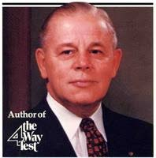
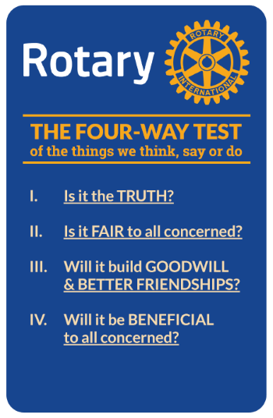
The Four-Way Test, which was created in 1932 by Rotarian Herbert J. Taylor (who later served as RI president), a young Chicago Rotarian who was tasked with saving the Club Aluminum company from bankruptcy.
Adopted by Rotary in 1943, The Four-Way Test has been translated into more than a hundred languages and published in thousands of ways.
Notes:
Initiate discussion by sharing the story of the 4 Way Test:
This is a similar situation to the one Rotarian Herbert J. Taylor confronted when he took over management of the Club Aluminum Company of Chicago in 1932 and created the Four-Way Test. He gathered four of his employees of different backgrounds who agreed that this test was consistent with the tenets of each of their religions.
Of the things we think, say, or do… Why this is an ethical statement for Rotarians and clubs?
Raise virtual hand and unmute to respond. Take one or two examples.

Slide 11
What are “ETHICS” in my Rotary and vocational life?
I have an ethical statement which guides me personally
My club has an ethics statement
My vocation has an ethics statement
Have you developed an ethics statement, personally or professionally
Launch POLL
Notes:
Emphasize that Rotarians are encouraged to consider ETHICS in the performance of all our activities.
In this exercise today we have considered the effects of actions by individuals which had serious consequences to the Rotary Club, Rotary Members and Rotary International.
Let’s look at our own situation as regards to ‘ethics’.
Introduce and launch the poll.
Share results and comment on them.

Slide 12
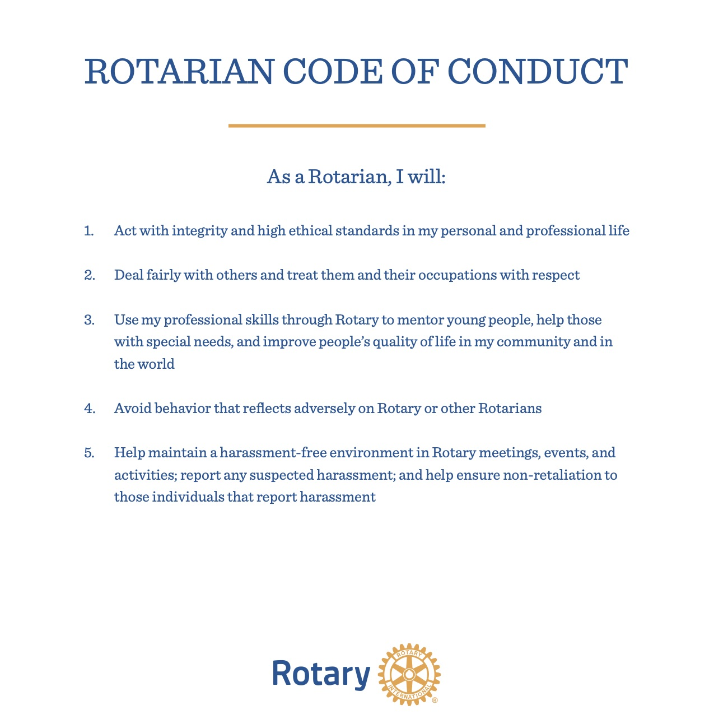
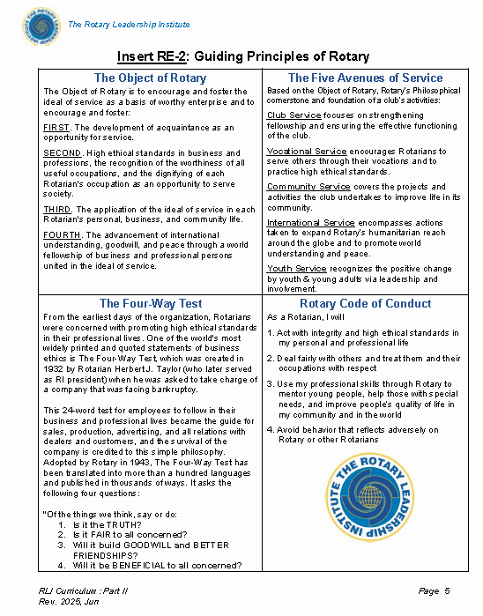
Notes:
BRIEFLY refer to Rotary’s Guiding Principles
Rotary has various statements available for guidance in our business and personal life. Look at INS: RE-2, “Guiding Principles of Rotary” in the participant manual. One of these is the “Rotary Code of Conduct shown.
As you can see , the ideals of the Four Way Test are included.
Point out where to find these resource documents for use by clubs.
NOTE: Do not take a lot of time with this as it is a document that is available to them as a reference.

Slide 13
Process – Making an Ethics Statement
Review Rotary International’s Code of Conduct
Determine key words for a preamble
Present to your club to gain support of Club Members and the Community
Develop procedure and timeline
Notes:
Conclude session by sharing the following:
Take a look at how to make an ethics statement. Many organizations have them; it is highly recommended that Rotary clubs take the time to form such a statement. Here’s a suggested process to perform that task. (on slide)
REVIEW RI’S CODE OF CONDUCT
DETERMINE KEY WORDS FOR A PREAMBLE
PRESENT TO YOUR CLUB
DEVELOP PROCEDURE AND TIMELINE
Suggest that participants check with their club leadership to see if their club has an ethics statement and if not they can make it happen.

Slide 14
Summary
How should the Guiding Principles of Rotary strengthen me in my vocation?
Does your club need an ethics statement? Why or Why not?
What are the foundation principles of Rotary and how do they guide ethical behavior of Rotarians?
How can I promote ethical behavior within my Club and vocation?
Notes:
Have participants refer to the questions on the screen and offer their final thoughts.

